Slide 1
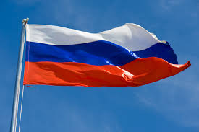
RUSSIA

Slide 2
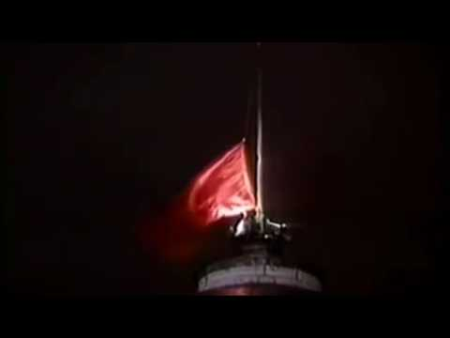
Notable History
-1812: Napoleon’s Army invades Russia, almost succeeds but runs out of food
-1914: Russia enters WW1 in defense of pan-slavism
-1917: Russian Revolution; the Tsars are permanently overthrown & replaced by Lenin + The Communist Party of the USSR
-1925: Stalin rises to power: purges Red Army officers, begins rapid industrialization of USSR (5 Year Plan)
-1939: WW2 begins; USSR seizes Eastern Poland, Baltic States; as buffer zones
-1942: Hitler invades USSR, almost succeeds
-1945: WW2 ends; 24 million Soviet deaths
-1950 to 1980: Golden Age of the USSR; recognized as world power with influence around the globe, rivalling US
-1991: USSR collapses, political chaos ensues across former satellites and states, Boris Yeltsin becomes president of The Russian Federation
-2000: Vladimir Putin is elected to his first term as president of Russia
-

Slide 3
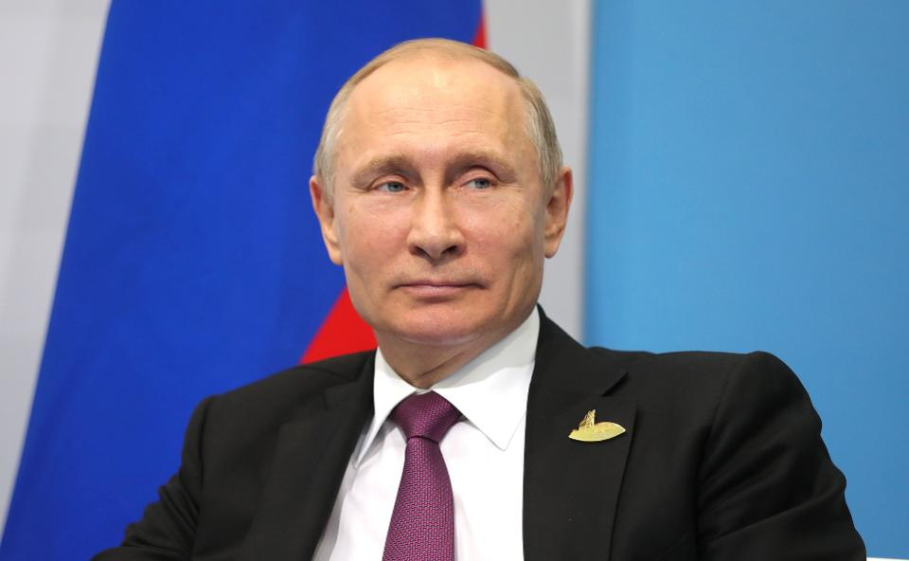
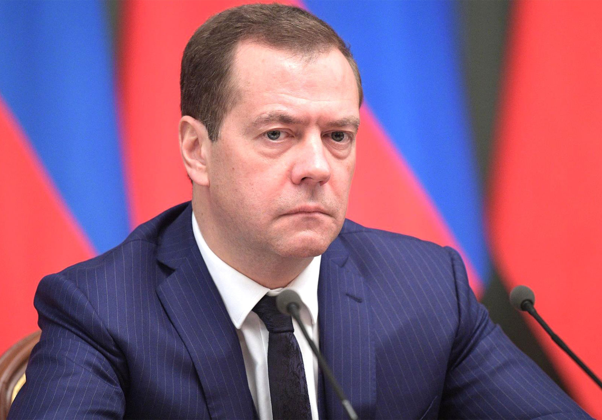
Government
Chief of State: President Vladimir Putin
Head of Government: Premier Dmitry Medvedev
Govt. Type: semi-presidential federation
Legislature: bicameral Federal Assembly
Federation Council (170 seats)
State Duma (450 seats)
Judiciary: Constitutional Court (19 judges)
Supreme Court of the Russian
Federation (170 seats)

Slide 4
Economy
Predominantly statist (standoff with the west delayed Russia’s transition to a more market-based system)
Wealth concentrated in the hands of the officials, particularly in energy, transportation and banking
Natural resources: coal, oil, natural gas
Prone to boom and bust cycles as global oil and gas prices fluctuate
GDP $4.016 trillion
Exports: $353 billion in value. China, Holland, Germany, Belarus, and Turkey
Imports:$238 billion in value. China, Germany, US, Belarus, Italy, and France

Slide 5
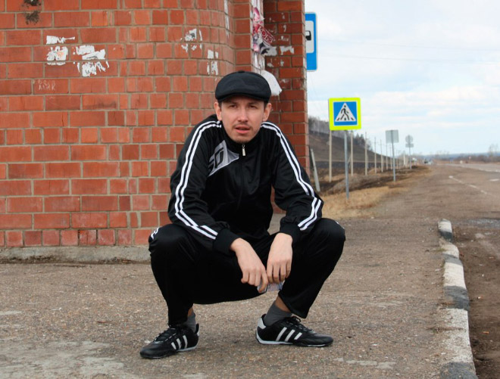
Demographics
Population: 142.1 million Population Growth: -0.11%
74.4% urbanized, 0.18% rate of urbanization, 99.7% literacy
Ethnicity
Russian - 77.7%
Tatar - 3.7%
Ukrainian - 1.4%
Chuvash - 1.0%
Chechen - 1.0%
Other - 10.2%
Unspecified - 3.9%
Language
Russian - 85.7%
Tatar - 3.2%
Chechen - 1.0%
Other - 10.1%
Religion
Russian Orthodox - 15-20%
Muslim - 10-15%
Other Christian - 2%

Slide 6
